Slide 1
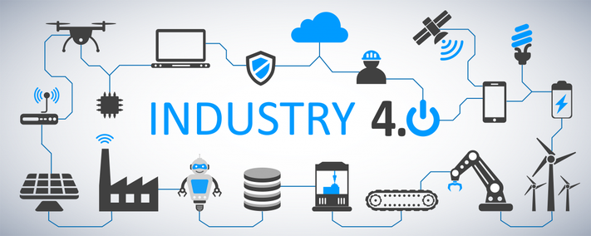
Perak Technology Academy
Industry 4.0

Slide 2
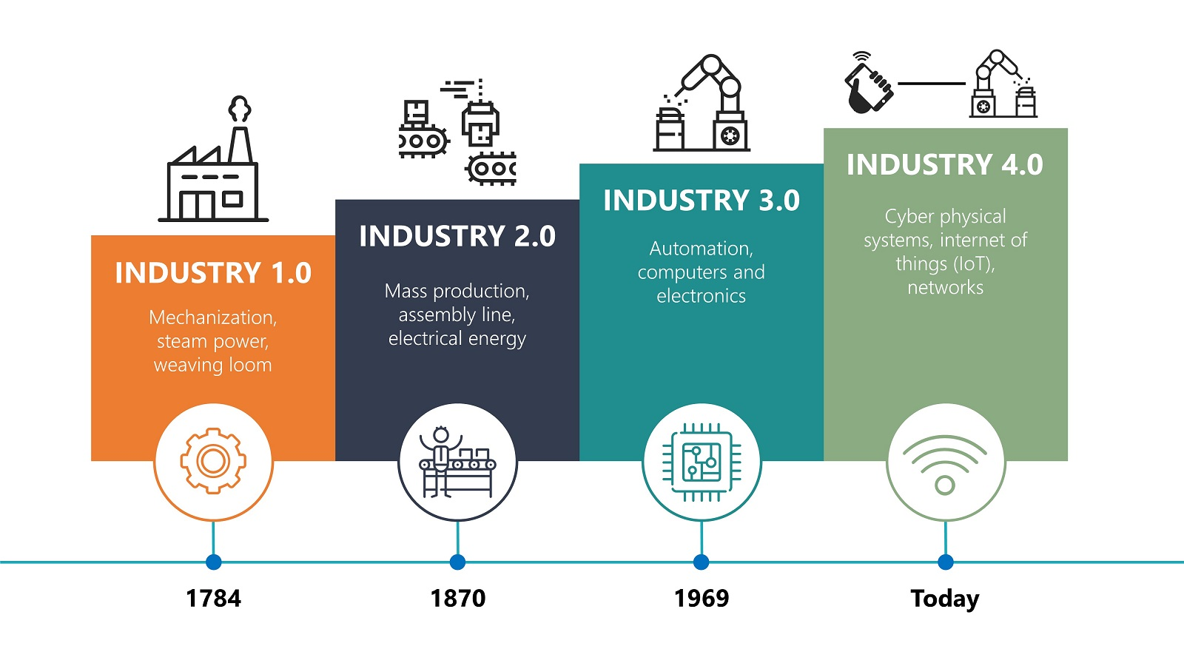
Industry Revolution

Slide 3
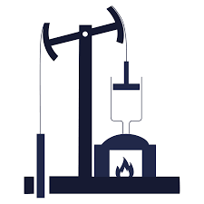
Industry 1.0
Between 1760 and 1820
Mechanical production machines
Manual labour performed by people and aided by work animals
Powered by water & steam
Textile manufacturing, iron industry, agriculture, and mining

Slide 4
Industry 2.0
Between 1870 and 1914
The technological revolution
Mass production manufacturing powered by electricity
Extensive railroad networks and telegraph use for communication
Economic growth, with an increase in productivity
Many workers were replaced by machines

Slide 5
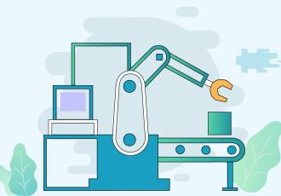
Industry 3.0
Between 1950 and 2013
The digital revolution
Autonomous production manufacturing
Extensive use of electronics, computer and communication technologies
The use of Internet for communication

Slide 6
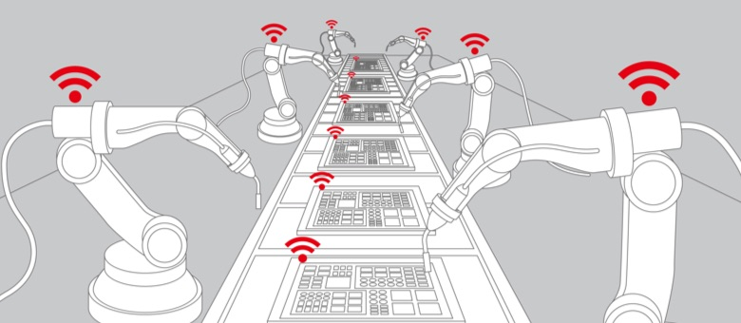
Industry 4.0
2013 German government memo outlined a plan to almost fully computerise the manufacturing industry without the need for human involvement
Sensors collect data that can be used to be analysed
Enhance it with smart and autonomous systems
Data driven and machine learning
Cyber-Physical System

Slide 7
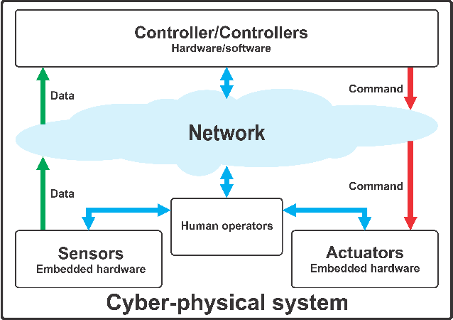
Cyber-Physical System
Interconnectivity through the Internet of Things (IoT)
Access to real-time data
Connects physical with digital
Allows better collaboration
Better control and understand every aspect of their operation
Leverage instant data to boost productivity

Slide 8
6 Design Principles
Interoperability: the ability of cyber-physical systems, humans and devices to connect and communicate with each other
Virtualization: a virtual copy of the cyber-physical systems by linking sensor data with virtual models
Decentralization: the ability to make decisions on their own
Real-Time Capability: the capability to collect and analyse data and provide the insights immediately
Service Orientation: offering of services via the Internet of Services
Modularity: flexible adaptation for changing requirements of individual modules

Slide 9
Additive Manufacturing
Big Data & Analytics
Autonomous Robot
Simulation
Industry 4.0
Internet Of Things (IoT)
Cloud Computing
System Integration
Cybersecurity
Augmented Reality

Slide 10
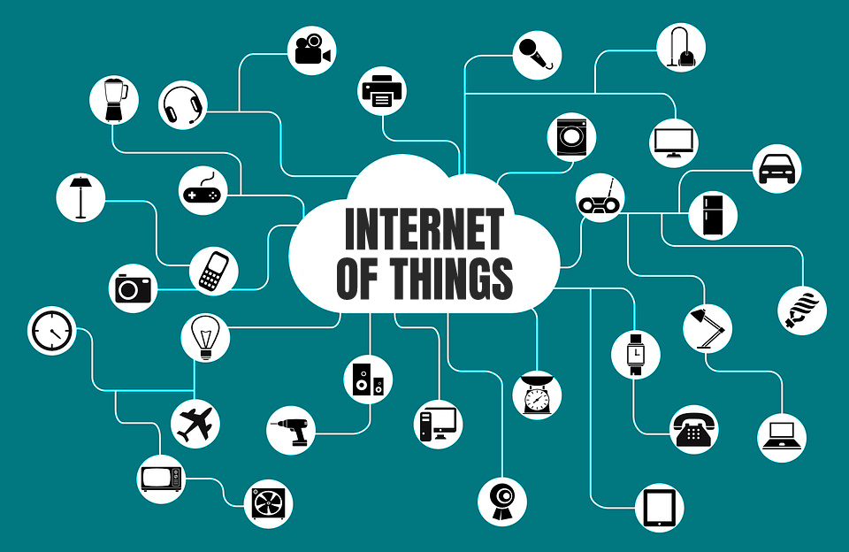
Internet Of Things (IoT)
All the sensors and actuators able to function separately and communicate with every other element
Devices to communicate and interact both with one another and with more centralized controllers
Reading and manipulation of the data for the purposes of saving time, manpower, energy and, ultimately, improving profits.

Slide 11
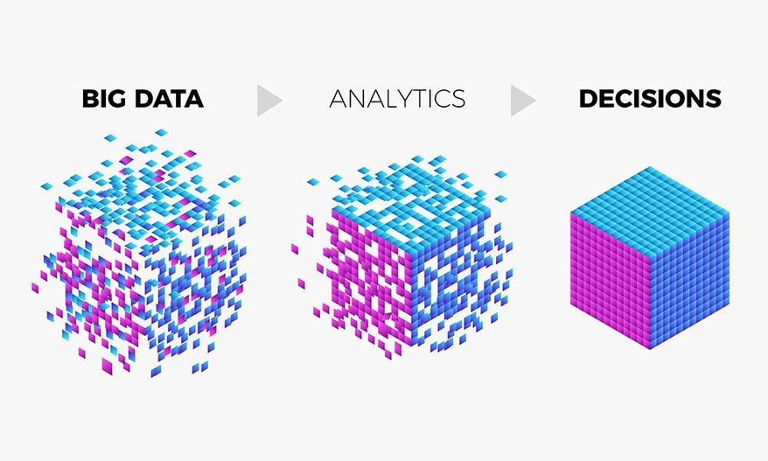
Big Data And Analytics
Data analytics and pattern recognition can reduce downtime and wastages
Data can be collected at different levels of manufacturing process
Predictive maintenance can be carried out based on the data collected.
Support real-time decision making.
Reveal inconsistent process performance or availability and visualise results.

Slide 12
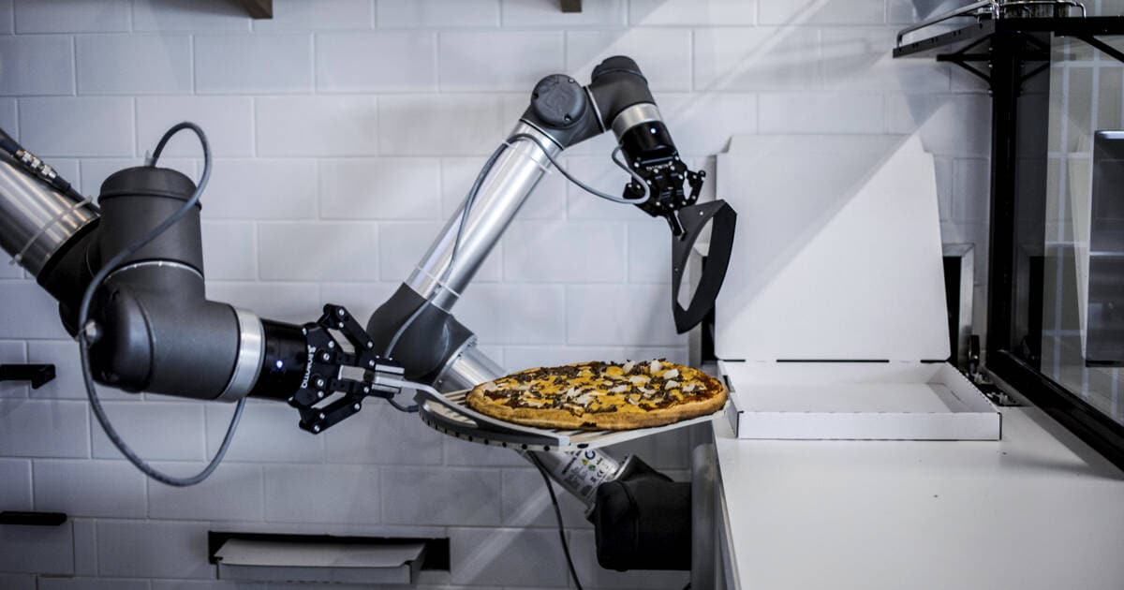
Autonomous Robot
Operate based on a complex logic algorithm
Interact with one another and work safely side by side with humans and learn from them.
Enabling machines to work more cohesively with their human counterparts
Diagnosing and repairing themselves and only alert when there is an issue during production

Slide 13
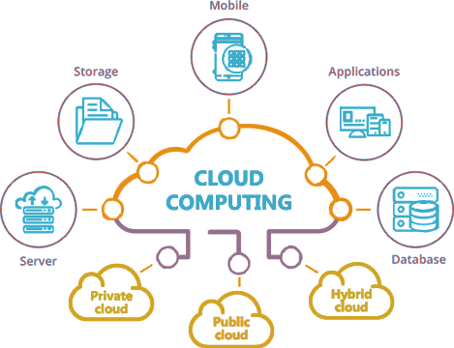
Cloud Computing
Remote system that can be accessed from anywhere using the internet
Increased data sharing across sites and company boundaries
Cloud services available today are IaaS, PaaS, SaaS
Communication among machines themselves and between machines and humans
Providing a data warehouse facility to organisations

Slide 14
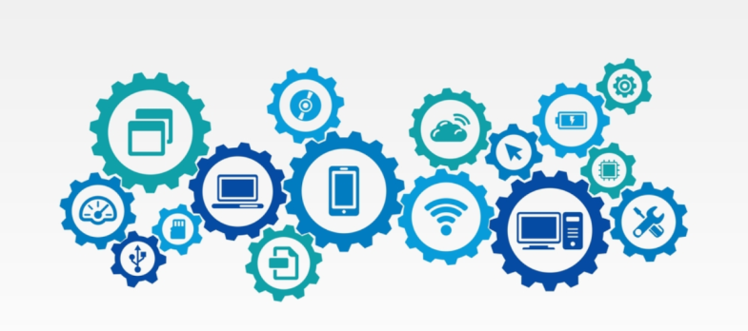
System Integration
Cohesive cross-company collaboration
Horizontal Integration takes networking among the cyber-physical systems and enterprise systems to an unprecedented level.
Vertical Integration makes every system and humans at all hierarchy has all the data with required abstraction
Challenge faced in vertical integration is the communication protocol
Overcome communication barrier by using interfaces

Slide 15
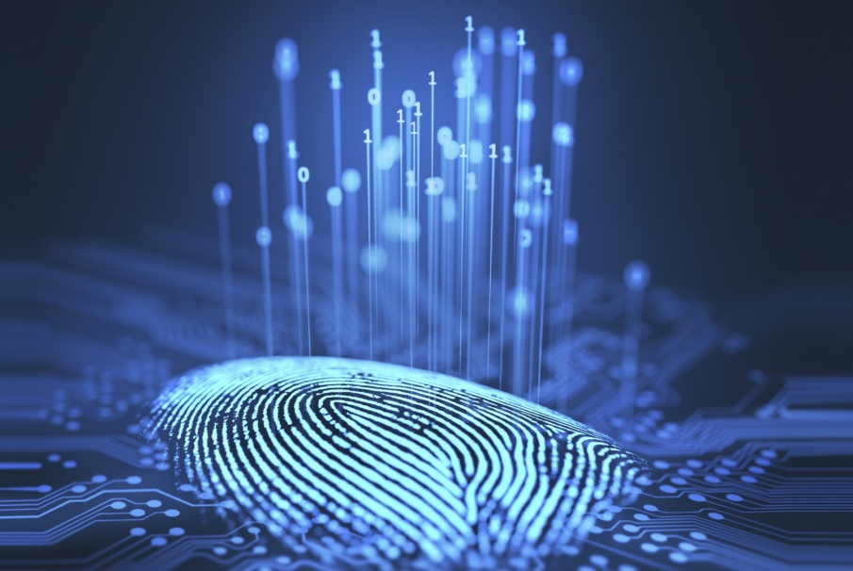
Cybersecurity
Any security breach could damage multiple areas of the business
Protection of computer systems from theft or damage to hardware, software or information and from disruption of the services provided.
Prepare and protect their information systems and production lines from cyberthreats
Secure, reliable communications as well as sophisticated identity and access management of machines

Slide 16

Simulation
Leverage real-time data and mirror the physical world in a virtual model
Test and optimize the machine settings for the next product in line in the virtual world before the physical changeover
Driving down machine setup times and increasing quality
Run more efficient tests so settings and processes are optimized before production even starts, reducing downtime and improving quality

Slide 17
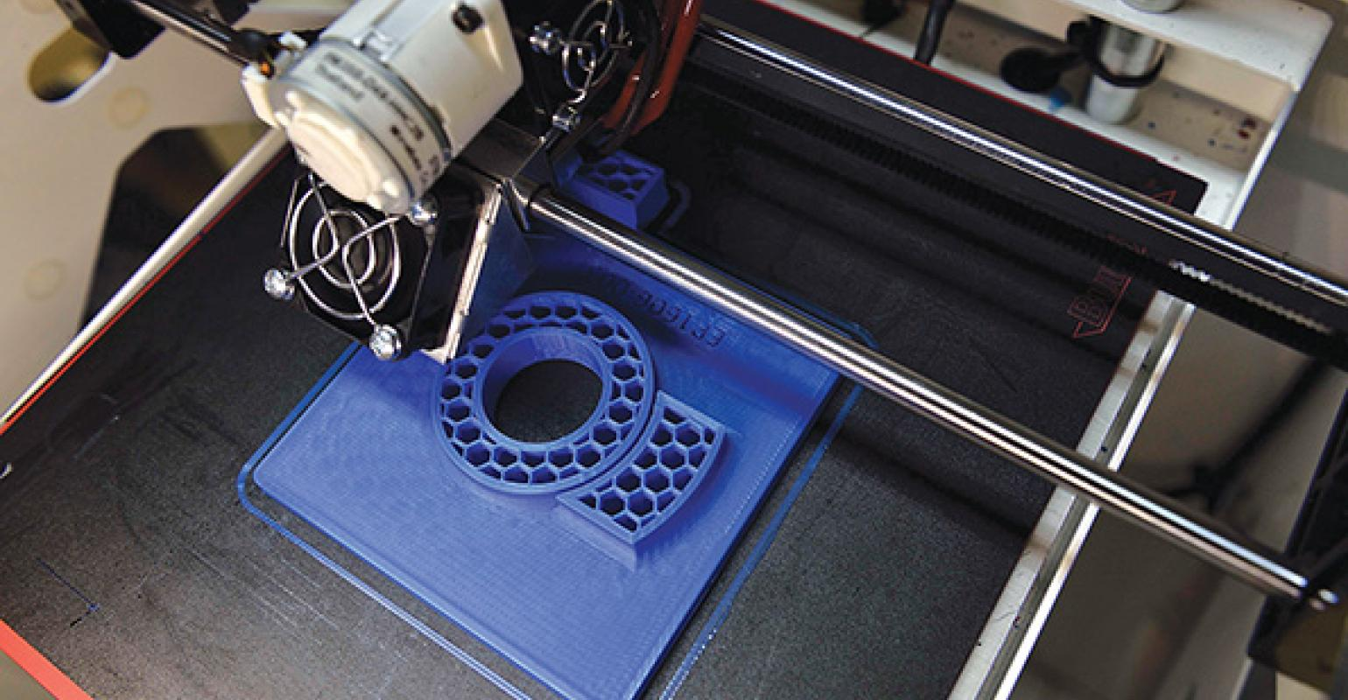
Additive Manufacturing
3D Printing allow prototype and produce individual components
Produce small batches of customized products
Allow low-cost prototyping to provide a high level or small run customized production
Create a three-dimensional object in which layers of material are formed under computer control.
Creating more complex geometric shapes and structures

Slide 18
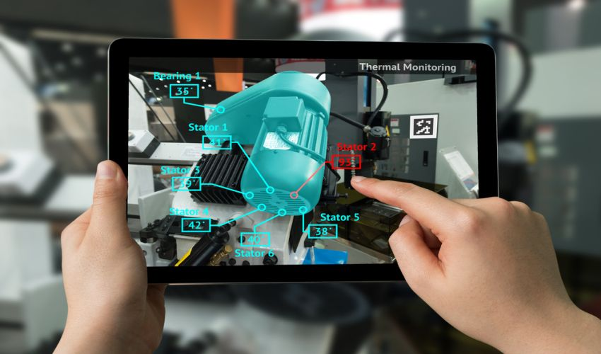
Augmented Reality
Creating computer-generated perceptual information it is becoming easier to train your staff, even in unique and difficult conditions
Provide training scenarios for humanitarian crisis aid or battlefield healthcare without risky in-field training
Superimposing computer-generated images combined with object recognition to a user’s view of the real world, giving an interactive hybrid view.
Displays digital content in the real word through a device, such as a mobile phone or special eyeglasses

Slide 19
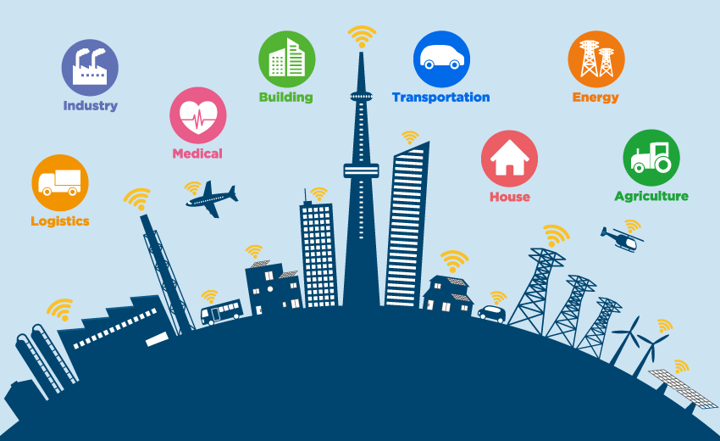
Smart City
SMART CITY

